Slide 1

CSE115A Winter Quarter 2021
LiftLog
Logging them lifts, Maxxing those gainz
THE HIGH FIVE
David Ralston Scrum Master
Ishan Pathirana
Rahul Arora Project Owner
Scott Zin
Yotam Golan

Slide 2

Motivation
Simplify Routine Tracking
Automate Exercise Adjustments
Simplified, User-Friendly UI

Slide 3
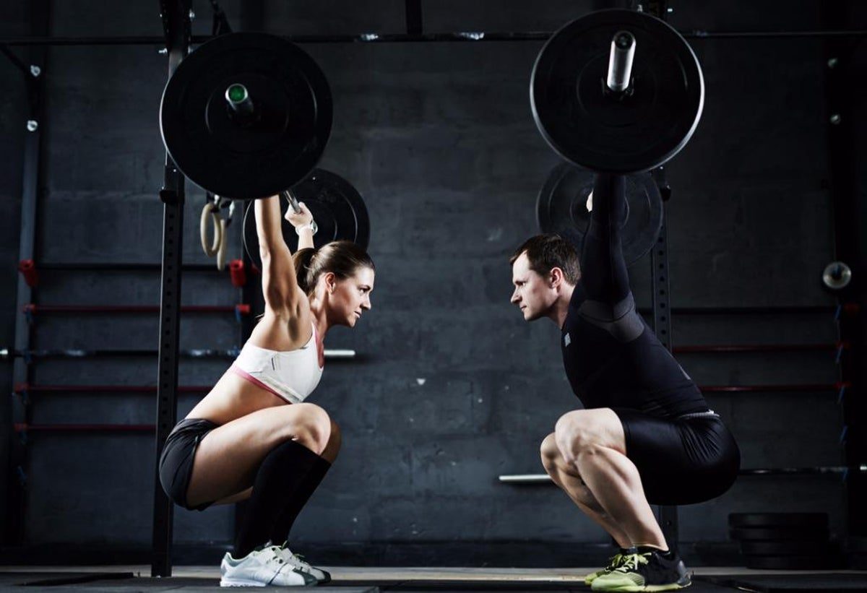
Goals Made
Simplify Routine Tracking
Automate Exercise Adjustments
Simplified, User-Friendly UI
Transfer Data Between Devices
Custom Workouts/Routines

Slide 4
Goals Achieved
Automate Exercise Adjustments
Simplified, User-Friendly UI
Transfer Data Between Devices

Slide 5
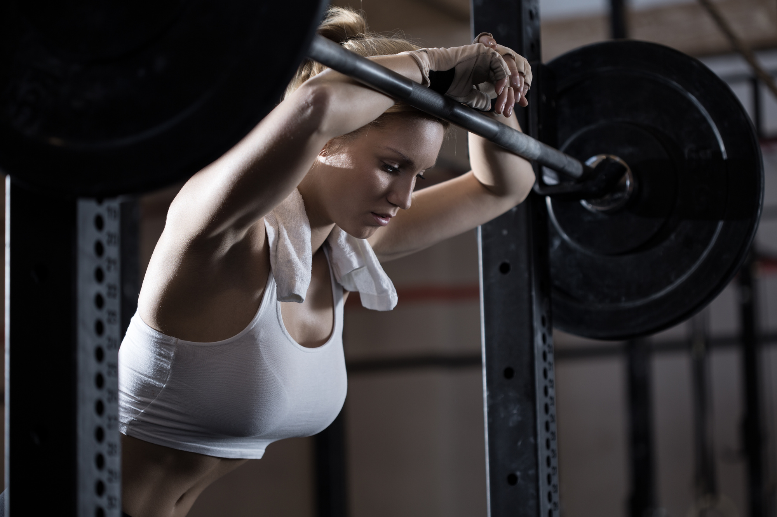
Challenges in Dev
Scope Creep on Tasks
Early Meeting Management
Difference in coding Strategies/Styles
Underestimating Effort Needed
Dependent Tasks

Slide 6

Challenges in Product
Time to implement key features
Data type resolution
Loading object from firebase
Images

Slide 7

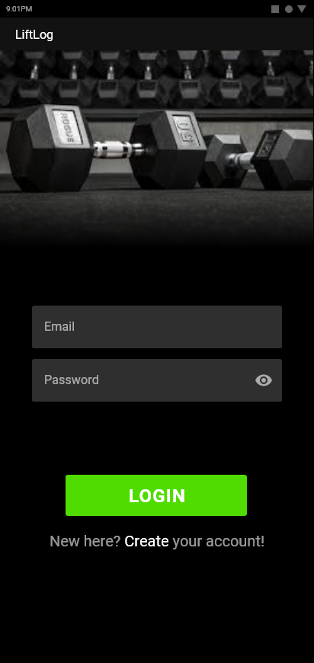
Live Demo
Create a User
Edit Profile
Select and Start a Routine
Complete a Workout

Slide 8
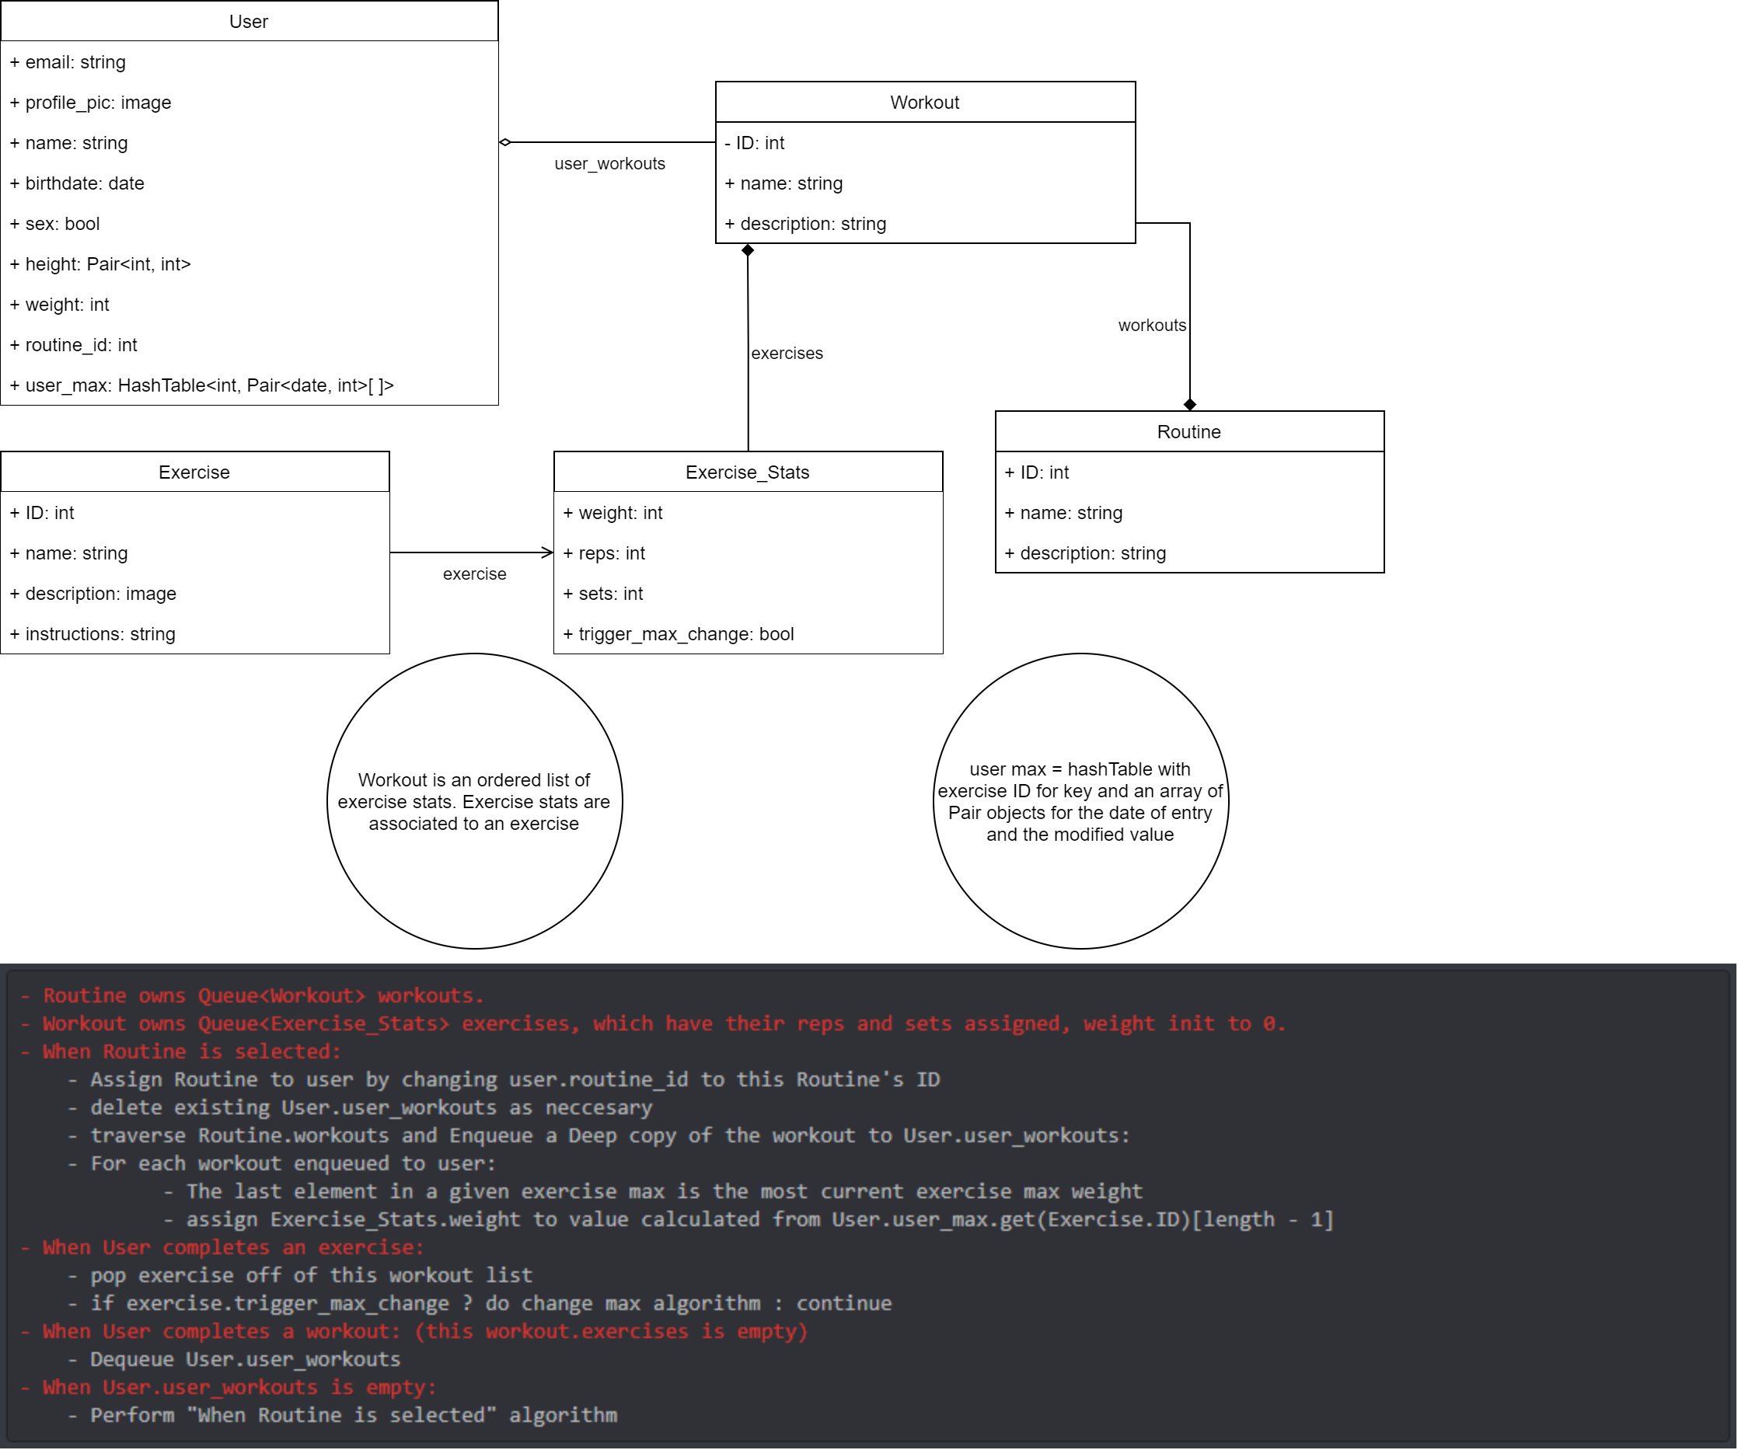
Model

Slide 9
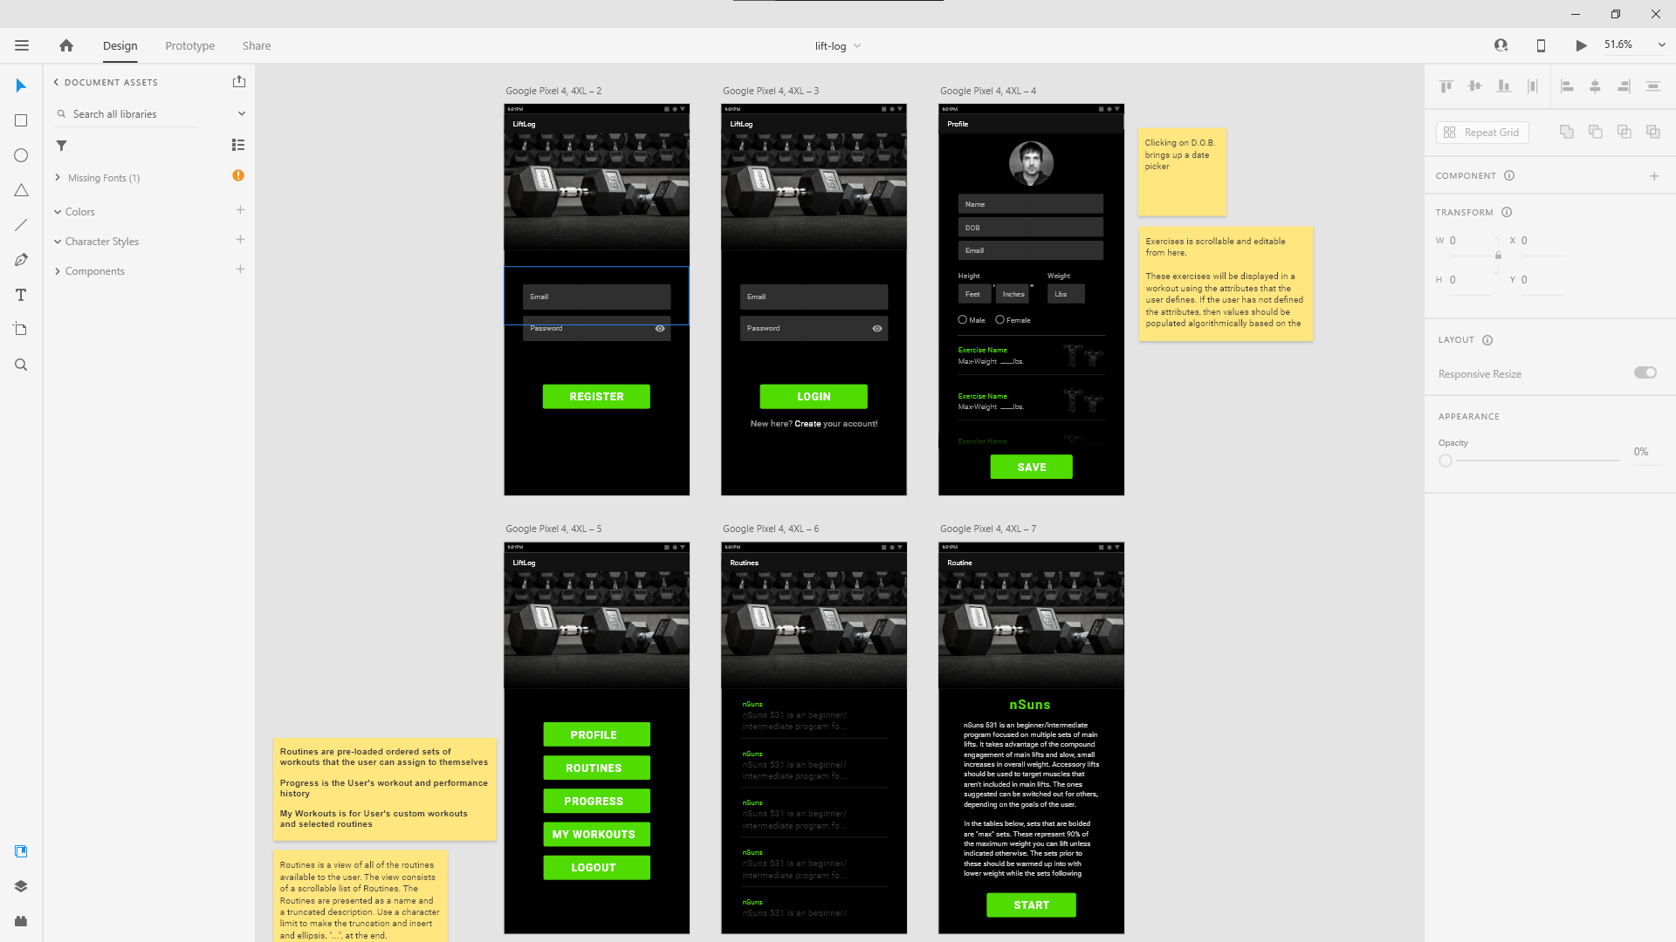
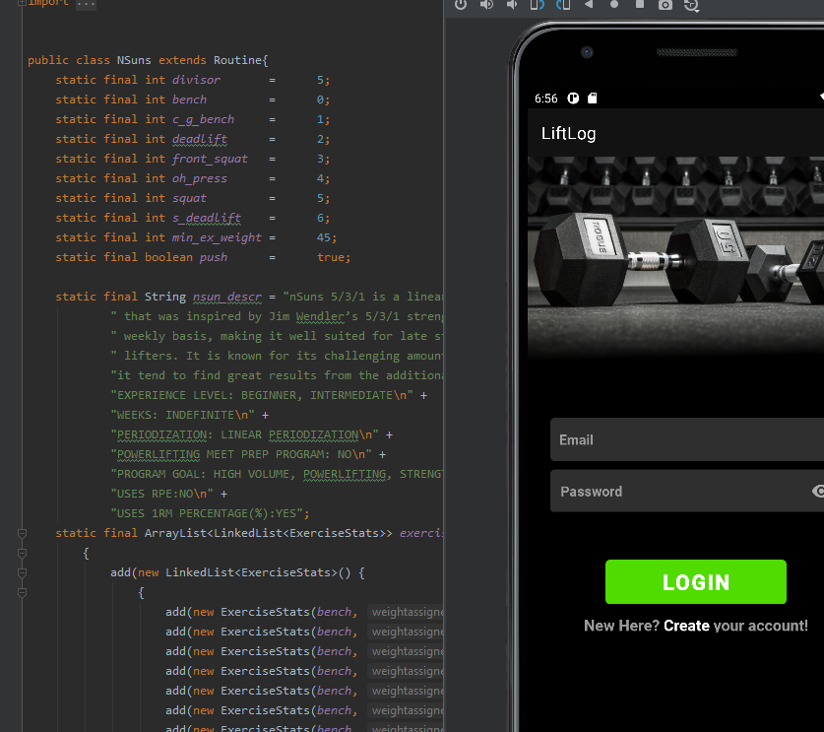
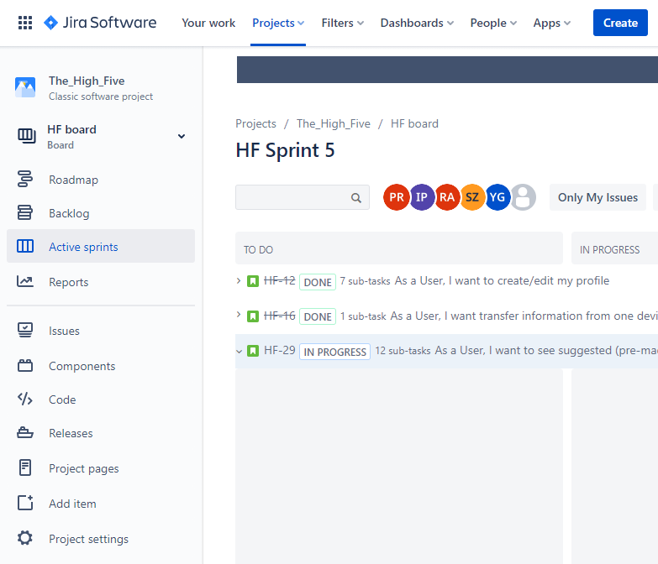
Technologies
Design
Develop
Deliver
Notes:
Design in AdobeXD
Develop in Android Studio
Manage the process using Jira

Slide 10
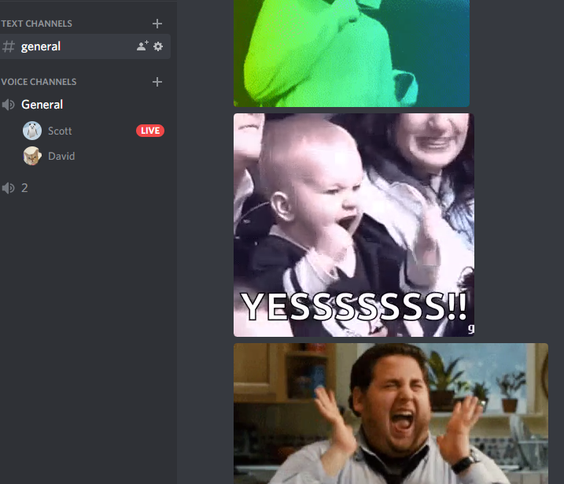
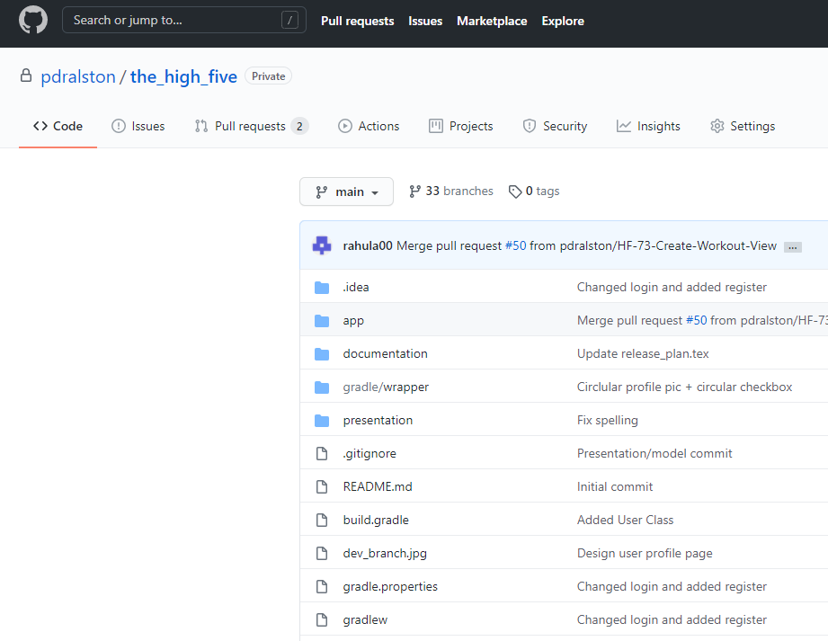

Technologies
Communicate
Collaborate
Chill Out
Notes:
Communication using Discord
Collaboration using Git
Team building in games and joking

Slide 11
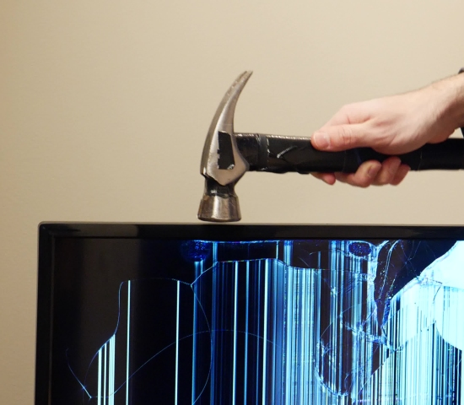
Techniques
Notes:
Git Repo Policy Stand ups after every class
Sprint Planning
Pair Programming

Slide 12
Notes:
Things we did and didn’t enjoy

Slide 13

Lessons
Notes:
What we would have done differently and why
What led to our best successes

